Slide 1





Welcome
To Our
Presentation

Slide 2

services
Teams
Future Plan
Vision
about
Target Group
Mr. Saloon
be Smart…
Color cut and more

Slide 3



Teams
Online Saloon Service
services
Vision
about
Future Plan
Target Group
Time to replace your Saloon visits with a more luxurious home-pamper session.
Saloon service and much more now at your doorsteps…

Slide 4

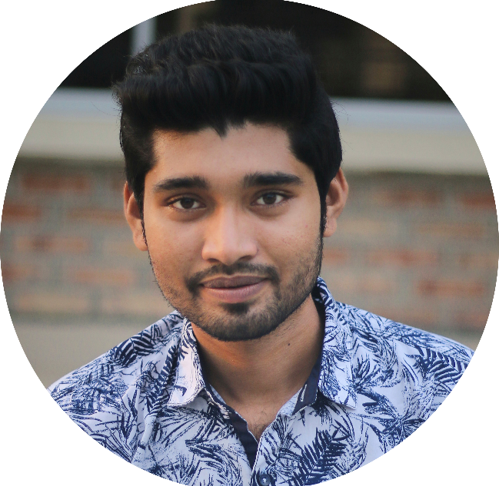
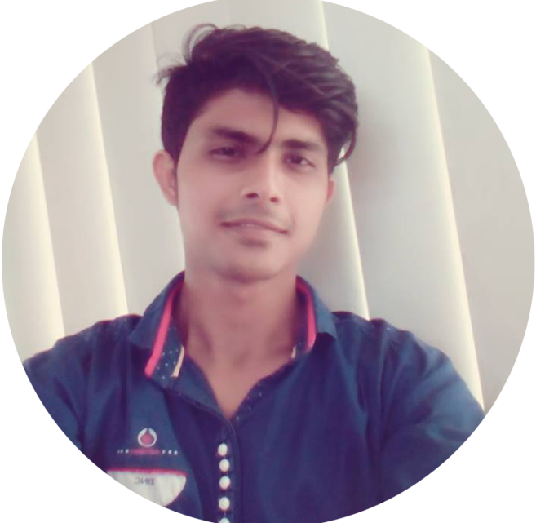
01
02
03
services
Vision
Teams
Future Plan
Target Group
about
Abdullah-Al-Zubayer
Rakibul Islam
Hosne Mobarock
Graphics Design, Web Developer
C, Java, Android Developer
C, Web Developer

Slide 5


Vision
Vision
Vision
1
2
3
services
Time
Quality
Comfort
Teams
Future Plan
Target Group
Vision
about
Save Peoples time from waiting a long…
Experts are Always provide quality service
Comfort for old & children as they are in their place

Slide 6
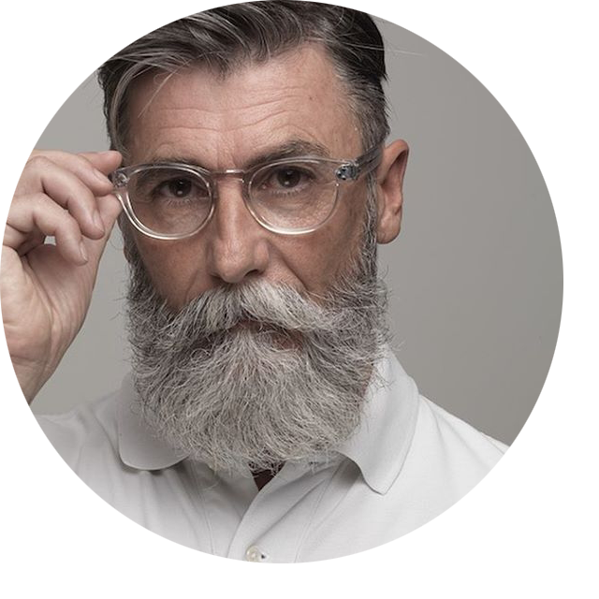
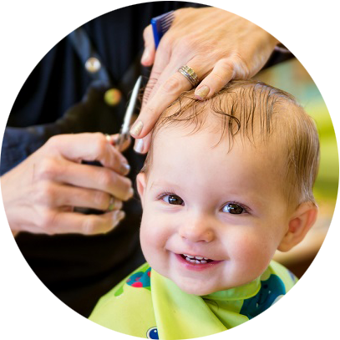

01
02
03
services
Teams
Future Plan
Vision
about
Target Group
Old Age
Children
Emergency
Aged People are need Extra care like as children
Save Parents time and children are more comfort as they with family
Emergency Service at any time any where…

Slide 7






Hair Cuts
Nail Treatment
Teams
Vision
about
Future Plan
Skin Care
services
Hair Color
Target Group
Dandruff Treatment
Massage
Many More…

Slide 8






Future Plan
For Business Expansion
December 2020
Launch Mr. Manager
December 2019
Place for All Event managers Over the Country…
Launch Our Own Saloon
It’s More important to Have a Saloon, That refers our strong Identity
services
history
teams
timeline
about
Future Plan
Future Plan
March 2019
June 2020
Starting Our Business
Launch Mr. Doctor
January 2020
Launching Website With apps
Online Appointment and 24/7 Touch with Doctors
Launch Mrs. Saloon
September 2019
Service For Women
Cover ALL Divisional City
To provide service all over the country, We first cover All Divisional City.

Slide 9
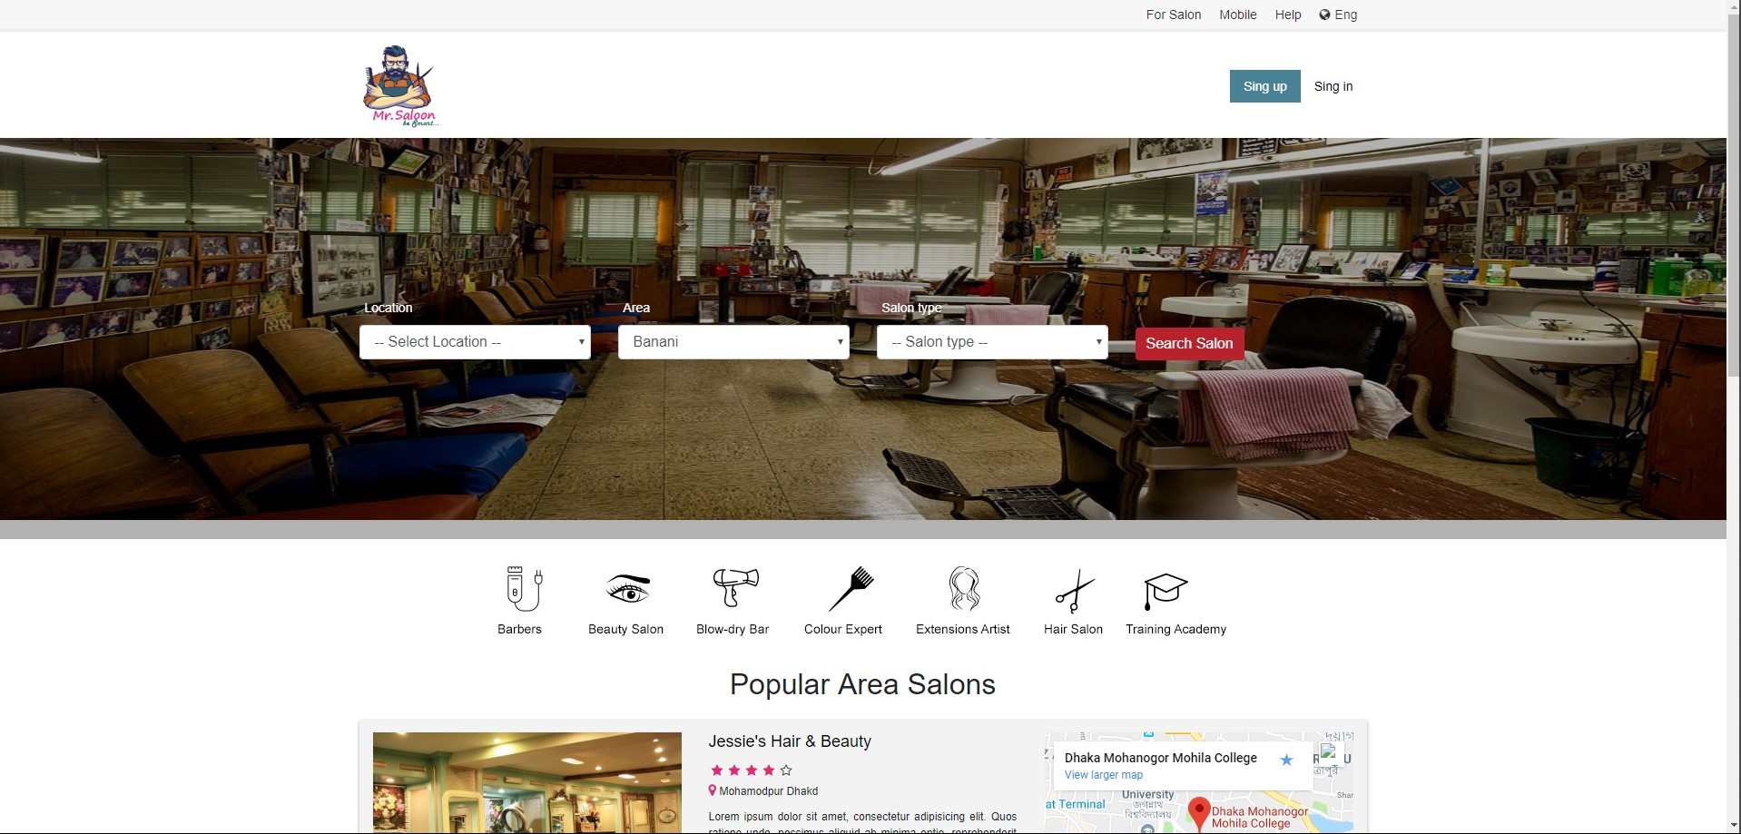
Project Website

Slide 10
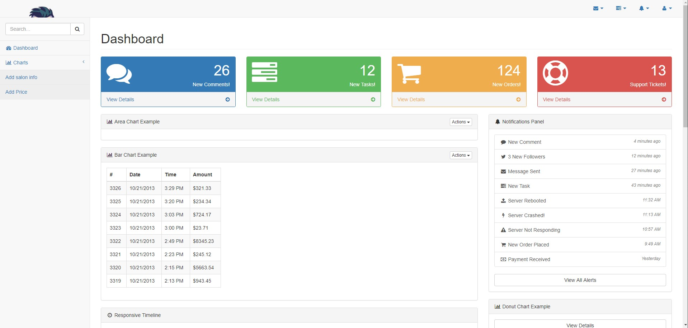
Project Website

Slide 11
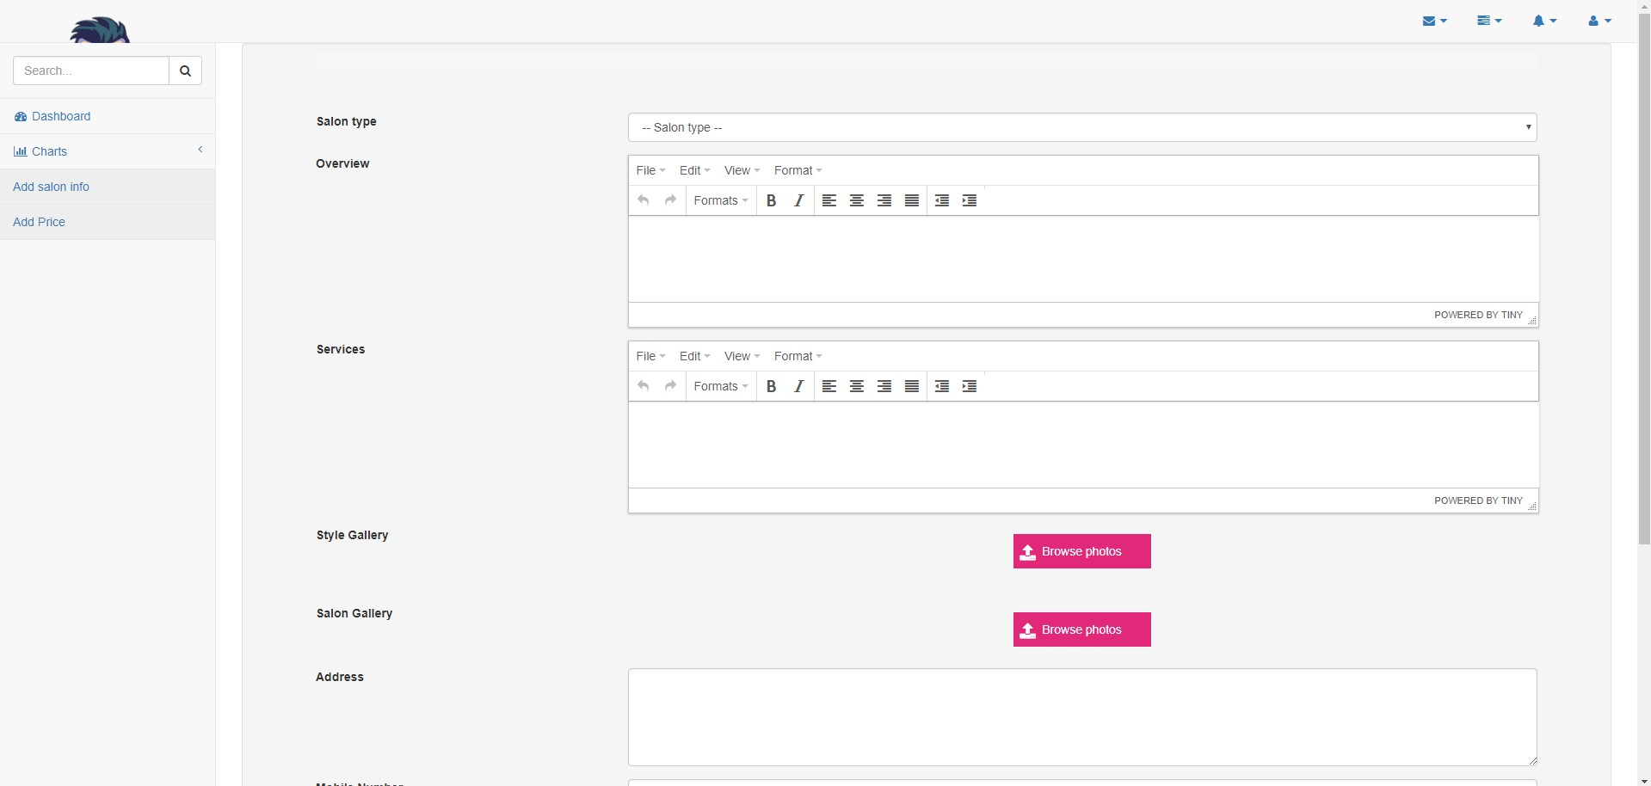
Project Website

Slide 12
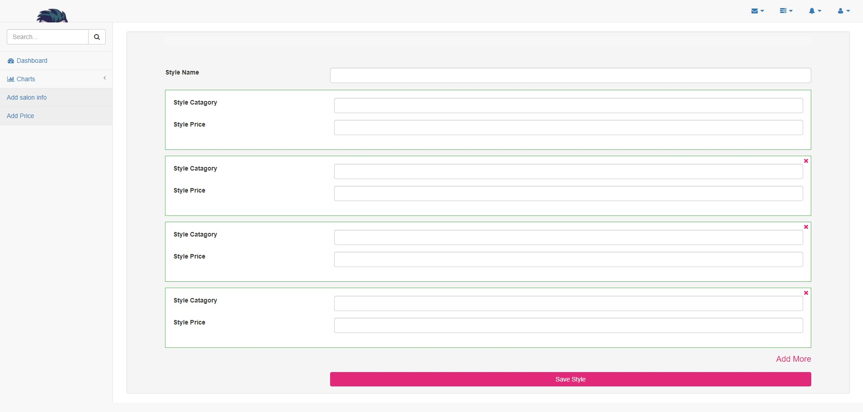
Project Website

Slide 13











Project Budget
Branding & Marketing
Website & Apps
2,00,000
20,000
More Marketing More Business
Total Cost With Domain & Hosting
SP Hunting
50,000
Find Expert Barber for Better Service
Total
28,20,000
Mr. Saloon
25,00,000
Own Saloon refers Strong Identity
Verify
50,000
Between Customer & SP

Slide 14
Thank You

